Slide 1
ONLINE
PRESENCE
AUDIT
Presented to Sample Client
Presented in March 2020

Slide 2
SAMPLE AUDIT NOTES.
Every audit is different, depending on what you’re looking for and what you’re currently doing
Remember, this is just a sample and your actual audit will have more notes on why these items are important, your specific data, and tailored suggestions
We find joy in (some) clip art
Contact sales@intellitonic.com to get started on your own!

Slide 3
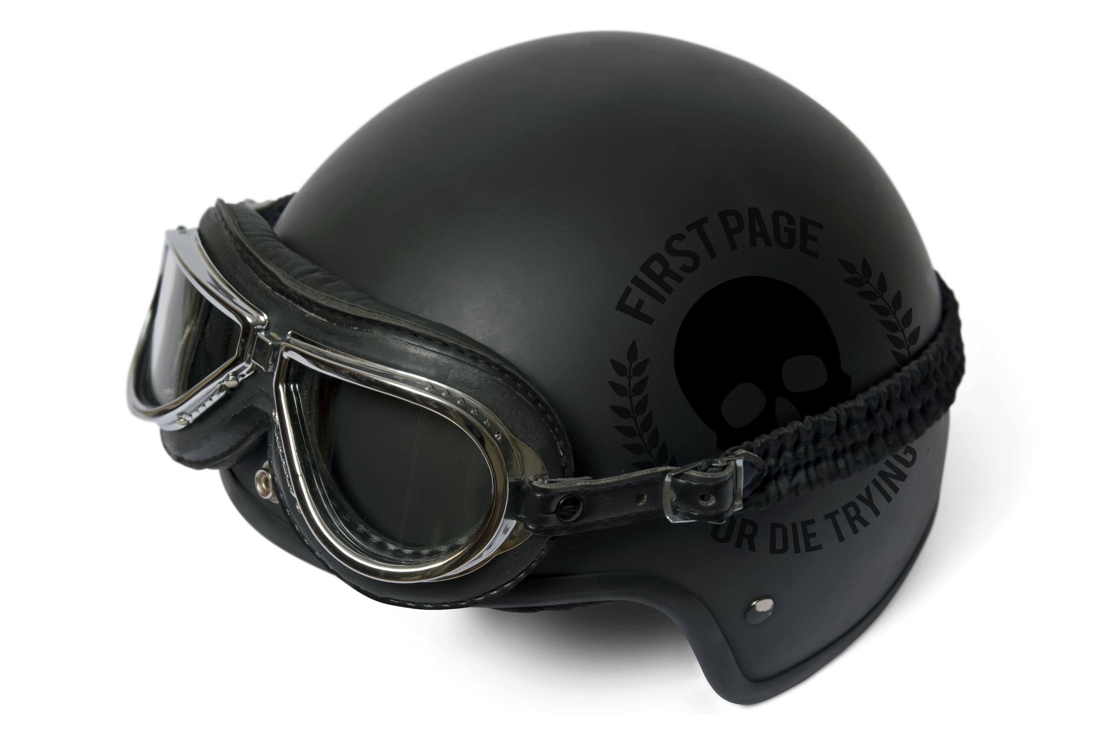
AGENDA.
Goals
Strengths
Opportunities
Suggestions
Notes

Slide 4
GOALS.

Slide 5
SAMPLE CLIENT GOALS.
Short-Term (6 months):
Re-position Sample Client to work better for their audience online
(e.g. direct website pathways for three service offerings, connect with visitors on a more personal level, and modernize the look)
Long-Term:
Become the go-to company in your industry
(first to mind for all stakeholders)

Slide 6
STRENGTHS.

Slide 7
WEBSITE STRENGTHS.
A Google search for “related:sampleclient.com” returns liked-minded competitors
Robots.txt file looks good
Site speed
Mobile: 67 / 100
Desktop: 76 / 100
All pages have header tags
Bounce rate at about 50%

Slide 8
PLATFORM STRENGTHS.
What’s working well e.g. strategy, consistency, format, pictures
Benchmarks against the industry in general
Benchmarks against your competitors specifically

Slide 9
OPPORTUNITIES.

Slide 10
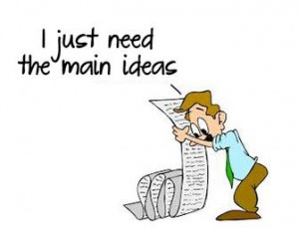
WEBSITE ISSUES SUMMARY.
Images: broken images and missing alt text
Meta: missing page titles and meta descriptions
Content: page length less than recommended minimum
Links: broken internal and external links

Slide 11
MAJOR ISSUES.
Missing Sitemap
Canonicalization

Slide 12
IMAGES.
455 images are missing alt text (on 358 pages)
7 images are broken (on 14 pages)

Slide 13
META CONTENT.
Page Titles
All pages have an SEO page title
50 pages have duplicates
7 pages are too long or too short
Meta Descriptions
0 are duplicates
42 pages are missing it altogether
297 pages are too long or too short

Slide 14
GENERAL CONTENT.
207 pages have fewer than 250 words
6 pages have duplicate content issues
Top 25 pages have clean bounce rate
14 pages under 40% bounce rate
10 pages 41 to 65%
1 page at 83%

Slide 15
BLOG CONTENT.
 | 2018 | 2019 | 2020
Jan | - | 1 | 3
Feb | - | 4 | 1
Mar | - | 2
Apr | 15 | 0
May | 5 | 0
Jun | 4 | 1
Jul | 3 | 6
Aug | 1 | 3
Sept | 4 | 1
Oct | 3 | 3
Nov | 3 | 0
Dec | 3 | 1
Avg | 4.56 | 1.83 | 2
72 blog posts since 2015
39 blog posts have resulted in
keyword rankings
3 of those are project focused
11 are culture focused
3 are general blog pages
2 based on community happenings
Project related pages were more likely to result in more keyword rankings

Slide 16
LINKS.
Internal
Three broken links (404s)
91 links missing anchor or alt text
33 links use rel=”nofollow”
External
15 broken links (404s)
15 links missing anchor or alt text
Trust Flow: 12 / 100
Citation Flow: 11 / 100

Slide 17
LOCAL SEO.
San Luis Obispo, CA (68%)
Santa Barbara, CA (65%)
Bend, OR (53%)
Bellingham, WA (47%)
Pasadena, CA (23%)
Tahoe, NV (19%)
Oakland, CA (18%)
Directories

Slide 18
TARGET KEYWORDS.
Describe your business at a “forest” level
Should be used throughout your web content to consistently remind search engines of your core focus
Speak to people who already know what your business is but noT necessarily who you are
Include suggested keyword targeting
Include blog topic ideas based on keywords

Slide 19
1ST & 2ND PAGE KEYWORD RANKINGS.
Current first page ranking keywords
Brand name (1, 2, 3, 4, 5, 6, 7, 8)
Service 1 (2,3,4)
Vendor 1 (3)
Vendor 2l (6)
Service 2 (7)
Owner (9, 11)
Project 1 (10)
Location + service (10)
Current second page ranking keywords
Brand name (11, 12, 14)
Service 1 (15)
Vendor 1 (17)
Vendor 2l (19)
Service 2 (20)
Owner (11, 12)
Project 1 (19)
Location + service (19)

Slide 20
PLATFORM SPECIFIC.
E.g. Facebook, Google Ads, LinkedIn, etc.
Frequency: post when you have something worth posting about, not for posting sake
Always include a photo and link back to your website
Talk about yourself, your vendors, industry trends, etc.
A|B testing is your friend

Slide 21
SUGGESTIONS.

Slide 22
HIGH PRIORITY.
Fix broken images
Update page titles and meta descriptions to include keyword research and adhere to length suggestions
Add more content and keyword targeting to pages less than 250 words, preferably 500 if possible
Don’t waste your time on culture blog posts and stick to actual projects
Fix broken links and missing anchor text for internal and external links
Increase number of backlinks pointing to your website from trustworthy companies, vendors, etc.
Utilize keyword research throughout your website to continue to improve keyword rankings and traffic
Add sitemap
Resolve for www.BigBusiness.com or BigBusiness.com
Update to https://

Slide 23
MEDIUM PRIORITY.
Set-up goals in Google Analytics for phone call and email tracking
Update image alt text using keyword research (while still accurately describing the image)
Blog more often + write blogs based off the blog topic ideas
Include a call-to-action or link to key page in blog post e.g. “Contact us”
Contact vendors, associates, etc. to write guest blogs
Update incomplete, inconsistent, and duplicative local listings
Increase page speeds
Make phone numbers on website clickable
Make email address on website clickable - add location specific emails?

Slide 24
LOW PRIORITY.
Use Annotations in Google Analytics
Use Google Campaign URL Builder to better understand traffic
Use Facebook and LinkedIn boosted ads to target new demographics and better understand how they use the website
Upload remarketing lists to Facebook and LinkedIn to stay top of mind
Add Google Ads and / or Bing to your marketing mix
Use the Google Campaign URL Builder to track paid ads
Brainstorm location and market specific directories

Slide 25
NOTES.

Slide 26
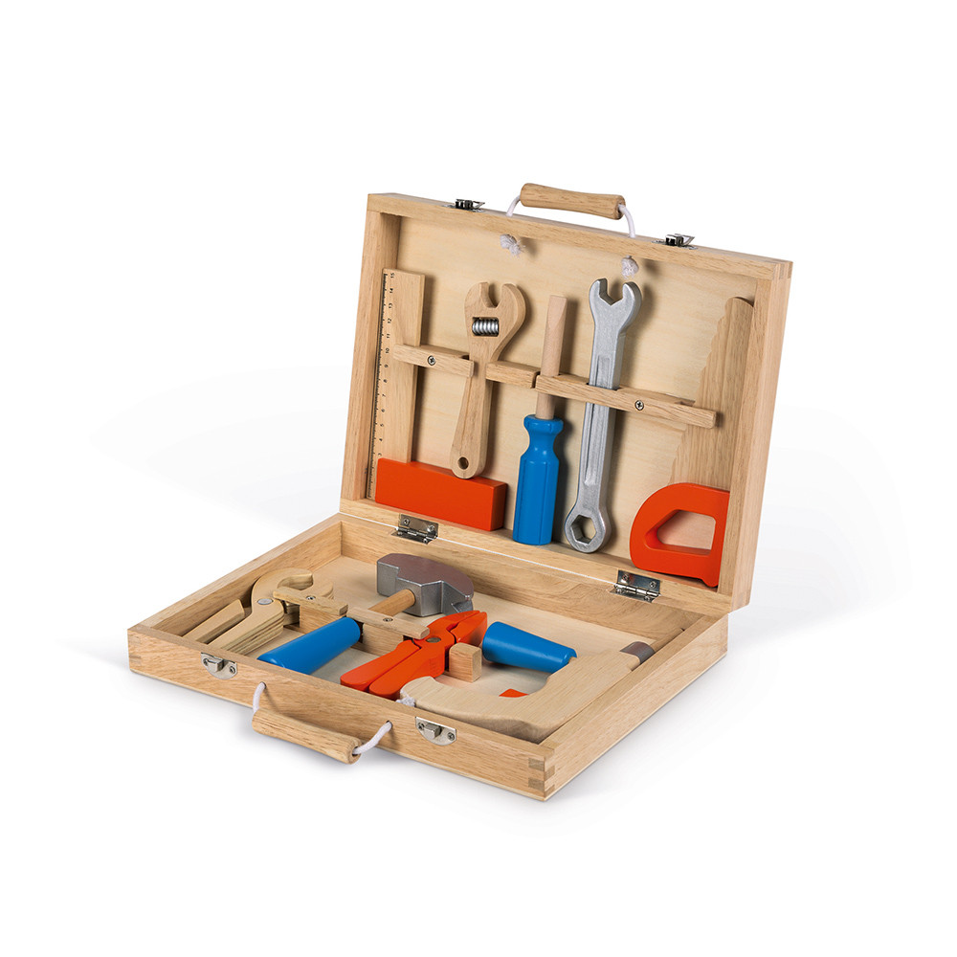
TOOLS USED.
Include fully fleshed out list of tools used, including, but not limited to:
Your CMS
Google Analytics
Google My Business
Google Search Console
Heat mapping
Platforms as necessary
Google Ads
Facebook Ads
LinkedIn Ads

Slide 27
QUESTIONS?
Contact sales@intellitonic.com

